Slide 1
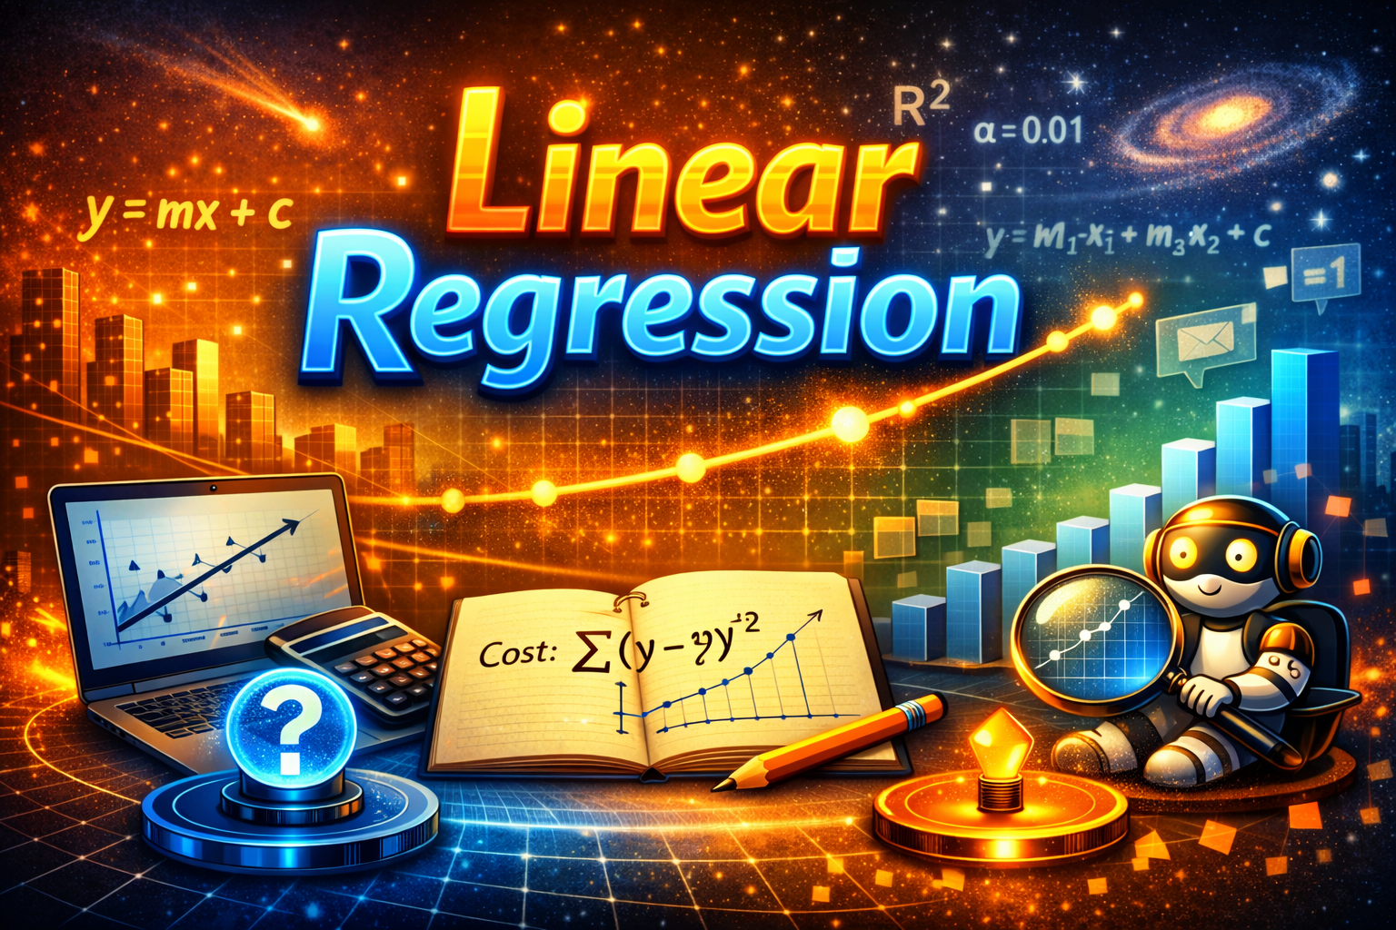
LINEAR REGRESSION
Dr ASHOK GOPALAKRISHNAN
SENIOR SCIENTIST FROM NASA

Slide 2
LINEAR REGRESSION
Regression analysis is a statistical method used to examine the relationship between a dependent variable (outcome) and one or more independent variables (predictors). It is widely applied in fields like machine learning, data science, economics, healthcare, and marketing to make predictions and understand variable relationships.
The primary goal of regression analysis is to model the relationship between variables, assess its strength, and use the model for prediction. It is a supervised learning technique, meaning it uses labeled data (training and testing datasets) to build and validate the model.
Applications of Regression Analysis:
Regression analysis has diverse applications across industries:
Finance: Predicting stock prices or analyzing the relationship between interest rates and consumer spending.
Marketing: Understanding the impact of advertising expenditure on sales.
Real Estate: Estimating property values based on location and other factors.
Agriculture: Predicting crop yields based on weather conditions.
Sports: Analyzing player performance and the impact of coaching strategies.

Slide 3
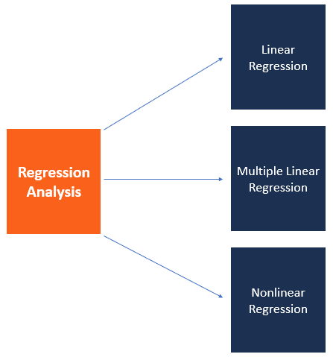
LINEAR REGRESSION
The most common models are simple linear and multiple linear. Nonlinear regression analysis is commonly used for more complicated data sets in which the dependent and independent variables show a nonlinear relationship.
Python and R are both powerful coding languages that have become popular for all types of financial modeling, including regression. These techniques form a core part of data science and machine learning, where models are trained to detect these relationships in data.

Slide 4
LINEAR REGRESSION
Advantages and Limitations
Regression analysis offers several benefits, such as insight into variable relationships, forecasting capabilities, and decision-making support. However, it is sensitive to outliers, relies on assumptions like linearity, and may struggle with complex relationships or multicollinearity.
In summary, regression analysis is a powerful tool for understanding and predicting relationships between variables, but its effectiveness depends on the quality of data and adherence to its assumptions.

Slide 5
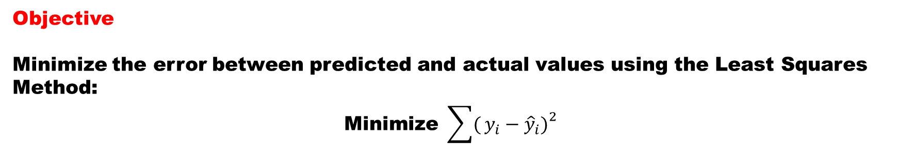
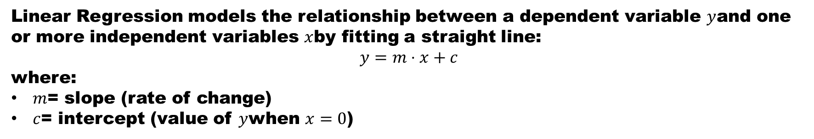
LINEAR REGRESSION
Linear Regression models the relationship between a dependent variable $y$and one or more independent variables $x$by fitting a straight line:
$$y=m⋅x+c$$
where:
$m$= slope (rate of change)
$c$= intercept (value of $y$when $x=0$)
Objective
Minimize the error between predicted and actual values using the Least Squares Method:
$$\text{Minimize} \sum{(}\left.y_{i}−{\hat{y}}_{i}{\left.)\right.}^{2}\right.$$

Slide 6
LINEAR REGRESSION
Simple linear regression is a model that assesses the relationship between a dependent variable and an independent variable. The simple linear model is expressed using the following equation:
Y = a + bX + ϵ
Where:
Y – Dependent variable
X – Independent (explanatory) variable
a – Intercept
b – Slope
ϵ – Residual (error)

Slide 7
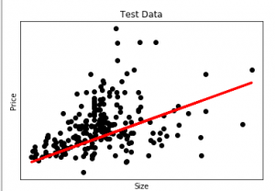
PYTHON FOR LINEAR REGRESSION
import pandas as pd
from sklearn import linear_model
from sklearn.model_selection import train_test_split
import matplotlib.pyplot as plt
df = pd.read_csv("Housing.csv")
Y = df['price']
X = df['lotsize']
X = X.to_numpy().reshape(len(X), 1)
Y = Y.to_numpy().reshape(len(Y), 1)
X_train, X_test, Y_train, Y_test = train_test_split(X, Y, test_size=0.2, random_state=42)
plt.scatter(X_test, Y_test, color='black')
plt.title('Test Data')
plt.xlabel('Size')
plt.ylabel('Price')
plt.xticks(())
plt.yticks(())
regr = linear_model.LinearRegression()
regr.fit(X_train, Y_train)
plt.plot(X_test, regr.predict(X_test), linewidth=3, color='red')
plt.savefig("regression_plot.png")
print("Plot saved as regression_plot.png")

Slide 8
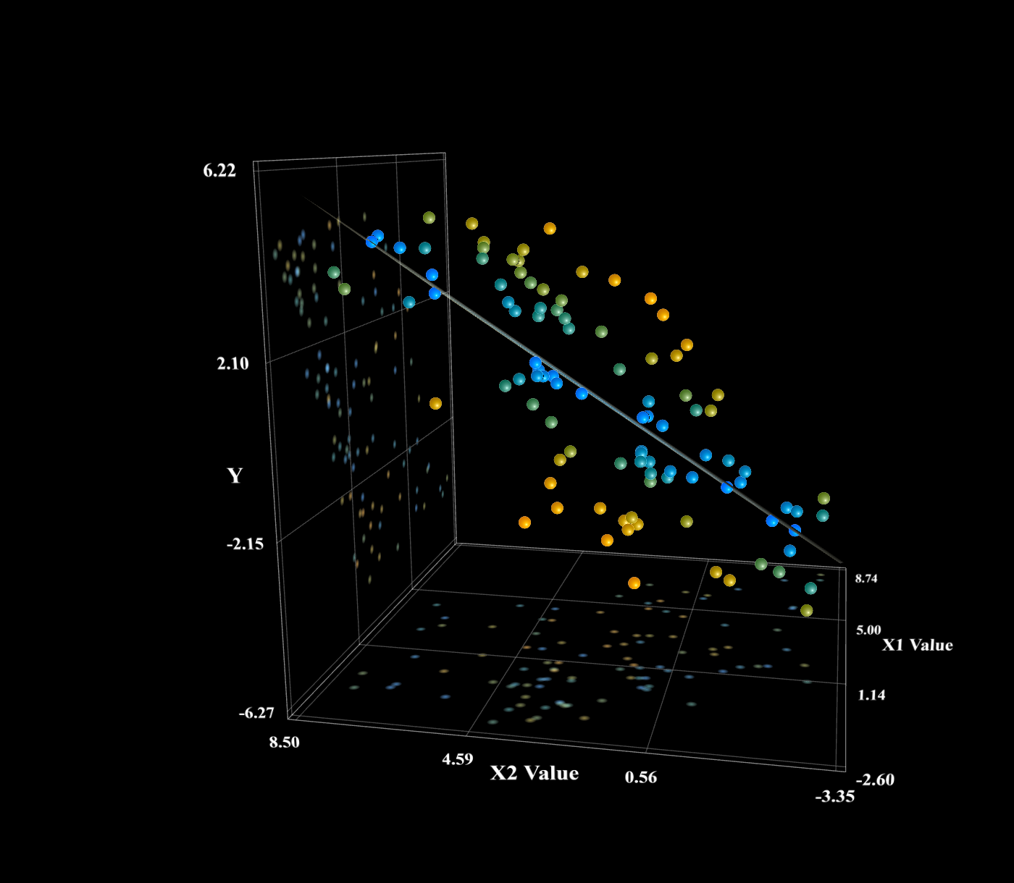
LINEAR REGRESSION
Regression primarily involves the grouping of points into clusters and then drawing
a straight line through them

Slide 9
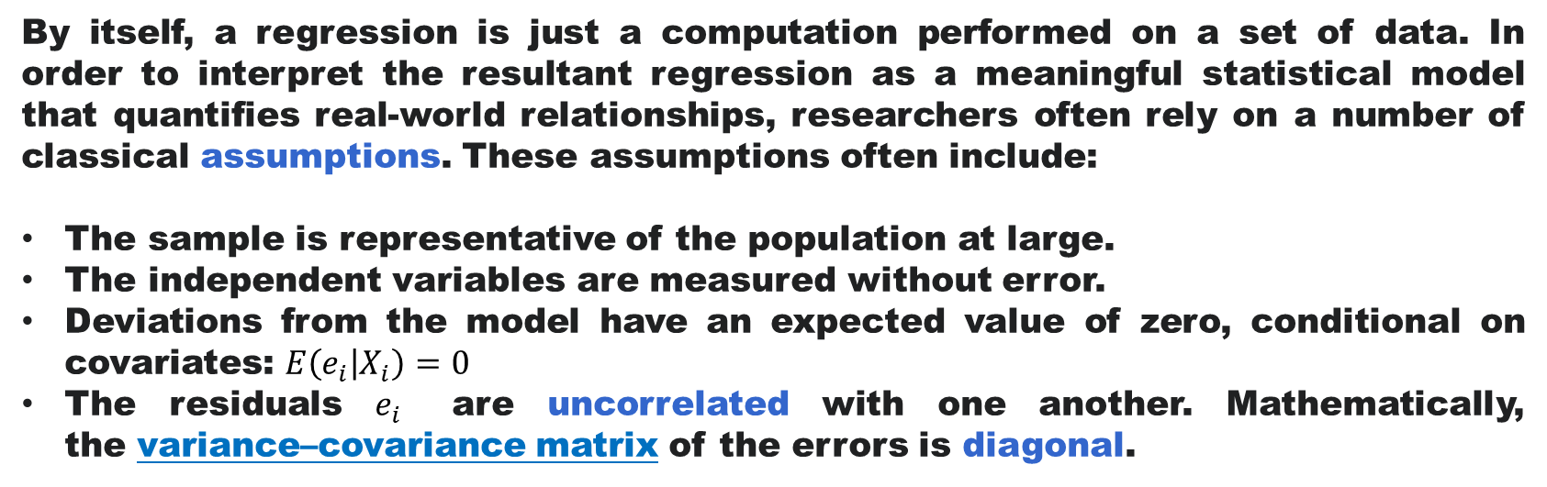
LINEAR REGRESSION
Regression analysis is primarily used for two conceptually distinct purposes. First, regression analysis is widely used for prediction and forecasting, where its use has substantial overlap with the field of machine learning. Second, in some situation’s regression analysis can be used to infer causal relationships between the independent and dependent variables.
By itself, a regression is just a computation performed on a set of data. In order to interpret the resultant regression as a meaningful statistical model that quantifies real-world relationships, researchers often rely on a number of classical assumptions. These assumptions often include:
The sample is representative of the population at large.
The independent variables are measured without error.
Deviations from the model have an expected value of zero, conditional on covariates: $E\left(e_{i} | X_{i}\right)=0$
The residuals $e_{i}$ are uncorrelated with one another. Mathematically, the variance–covariance matrix of the errors is diagonal.

Slide 10
LINEAR REGRESSION
Types of Regression Analysis
Type | Description | Example
Simple Linear Regression | One independent variable | Predict marks from study hours
Multiple Linear Regression | Two or more independent variables | Predict house price from area, rooms, and location

Slide 11
LINEAR REGRESSION
Intermediate Concepts of Regression Analysis
Assumptions
Linearity between variables
Independence of errors
Homoscedasticity (constant variance)
Normal distribution of residuals
No multicollinearity among predictors
Evaluation Metrics
R² (Coefficient of Determination) — how well the model explains variance
MAE / MSE / RMSE — error measures
Adjusted R² — adjusts for number of predictors
Visualization
Scatter plots, regression lines, and residual plots help verify assumptions visually.

Slide 12
LINEAR REGRESSION
“Implementation of Linear Regression means translating the math into a working model — defining the equation, minimizing error, and coding it so the computer can learn the best‑fit line. Whether we use Scikit‑Learn’s ready‑made tools or write gradient descent ourselves, the essence is the same: fitting a line that predicts outcomes.”
Notebook Structure: Linear Regression Implementation
“Implementation means translating math into code. First, we code the learning process ourselves. Then, we use Scikit‑Learn’s built‑in function. Both approaches will show how Linear Regression learns the best‑fit line — one step by step, the other instantly.”

Slide 13

LINEAR REGRESSION
Part 1: Manual Implementation (Gradient Descent)
Goal: Show how the algorithm learns slope $m$ and intercept $c$.
import numpy as np
import matplotlib.pyplot as plt
# Sample dataset
X = np.array([1,2,3,4,5])
y = np.array([2,4,5,4,5])
# Initialize parameters
m, c = 0, 0
alpha = 0.01
epochs = 1000
# Gradient Descent
for _ in range(epochs):
y_pred = m*X + c
error = y - y_pred
m -= alpha * (-2 * np.mean(X * error))
c -= alpha * (-2 * np.mean(error))
print("Slope (m):", m)
print("Intercept (c):", c)
EXERCISE FOR 22 JUNE 2026 TO BE DONE
TRY THIS CODE TO LEARN & LET ME KNOW THE OUTPUT

Slide 14
LINEAR REGRESSION
EXERCISE FOR 22 JUNE 2026 TO BE DONE
Part 2: Visualization of Fit
python
plt.scatter(X, y, color='blue')
plt.plot(X, m*X + c, color='red')
plt.title("Manual Linear Regression Fit")
plt.xlabel("X")
plt.ylabel("Y")
plt.show()
TRY THIS CODE TO LEARN & LET ME KNOW THE OUTPUT
Scatter points + regression line = ?
FILL IN THE BLANK & LET KNOW THROUGH CHAT TODAY

Slide 15
LINEAR REGRESSION
Part 3: Scikit‑Learn Implementation
EXERCISE FOR 22 JUNE 2026 TO BE DONE
Python
from sklearn.linear_model import LinearRegression
X = X.reshape(-1,1) # reshape for sklearn
model = LinearRegression()
model.fit(X, y)
print("Slope (m):", model.coef_[0])
print("Intercept (c):", model.intercept_)
print("Prediction for X=6:", model.predict([[6]]))
TRY THIS CODE TO LEARN & LET ME KNOW THE OUTPUT
Compare results with manual gradient descent.

Slide 16
LINEAR REGRESSION
Part 4: Reflection
Manual method shows the mechanics (gradient descent).
Scikit‑Learn shows the practical shortcut (ready‑made implementation).
Both lead to the same essence: fitting the best line to minimize error.
Linear regression is a supervised learning technique used to model the relationship between one or more independent variables (features) and a continuous dependent variable (target). It’s widely applied in forecasting, price prediction, and trend analysis.
Aditya‑L1 data analysis does use regression techniques. For example, researchers have applied logistic regression models to classify and detect solar phenomena such as Coronal Mass Ejections (CMEs) using payload data from SWIS‑ASPEX. Regression helps distinguish between normal solar wind variations and CME events by learning from labeled features.

Slide 17
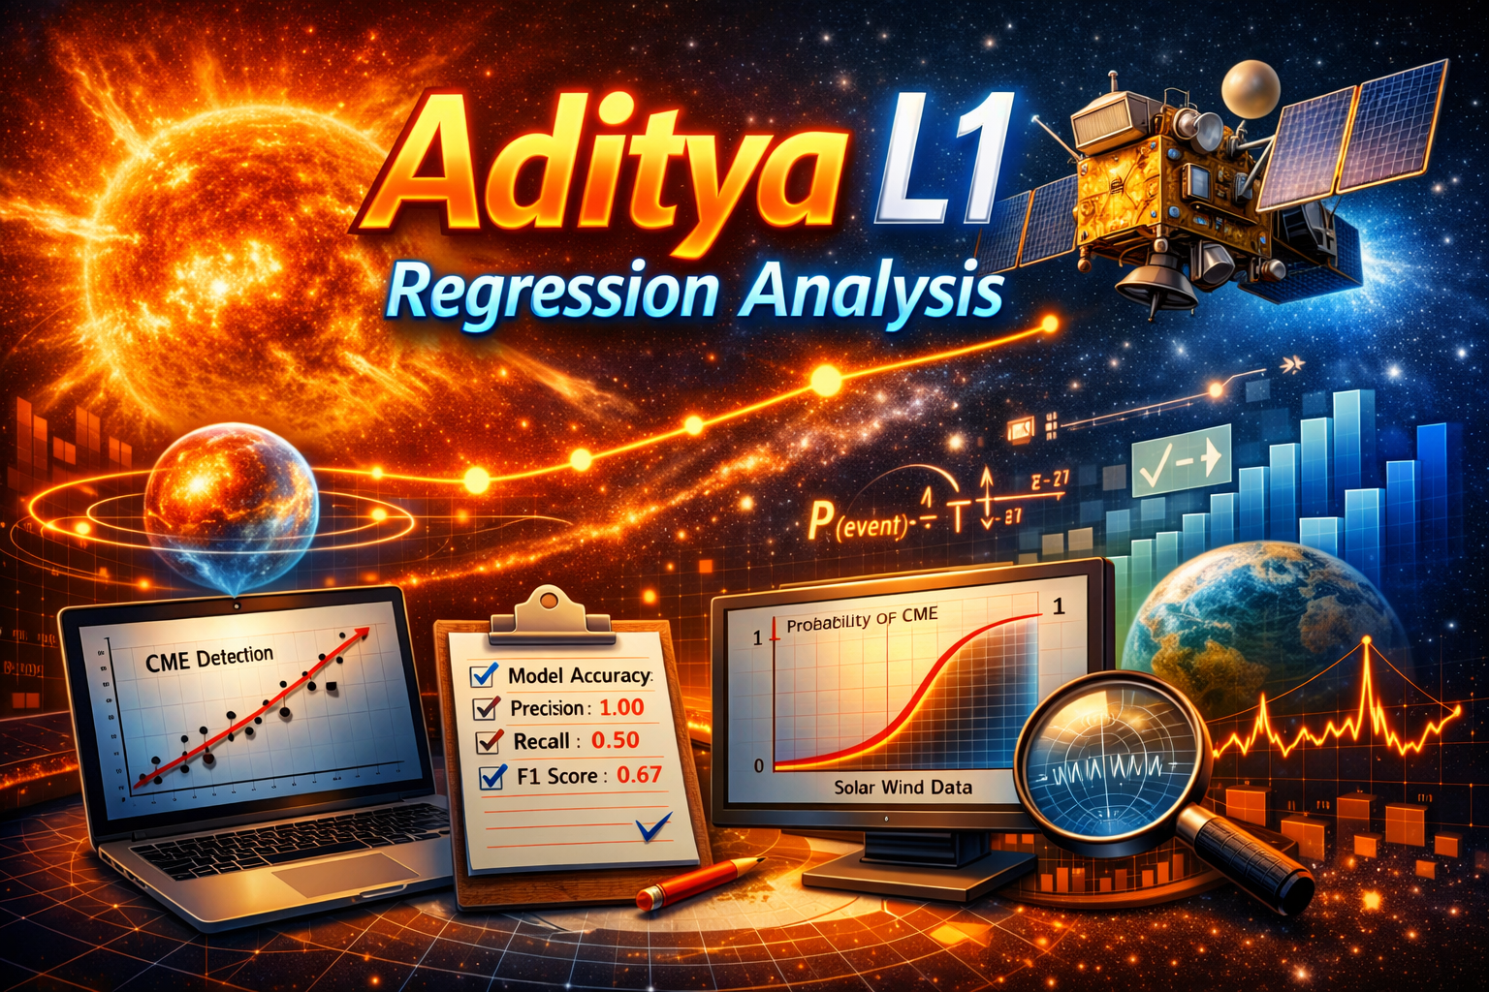
LINEAR REGRESSION
Aditya‑L1 spacecraft orbiting near Earth, facing the Sun.
Solar flares and CMEs erupting from the Sun, symbolizing raw data.
Regression graphs (scatter plots, logistic curve) on laptops and monitors, showing CME detection.
Metrics panel with precision, recall, and F1 score — linking regression analysis to event classification.
Color palette: Fiery oranges for solar activity, cool blues for data science.

Slide 18
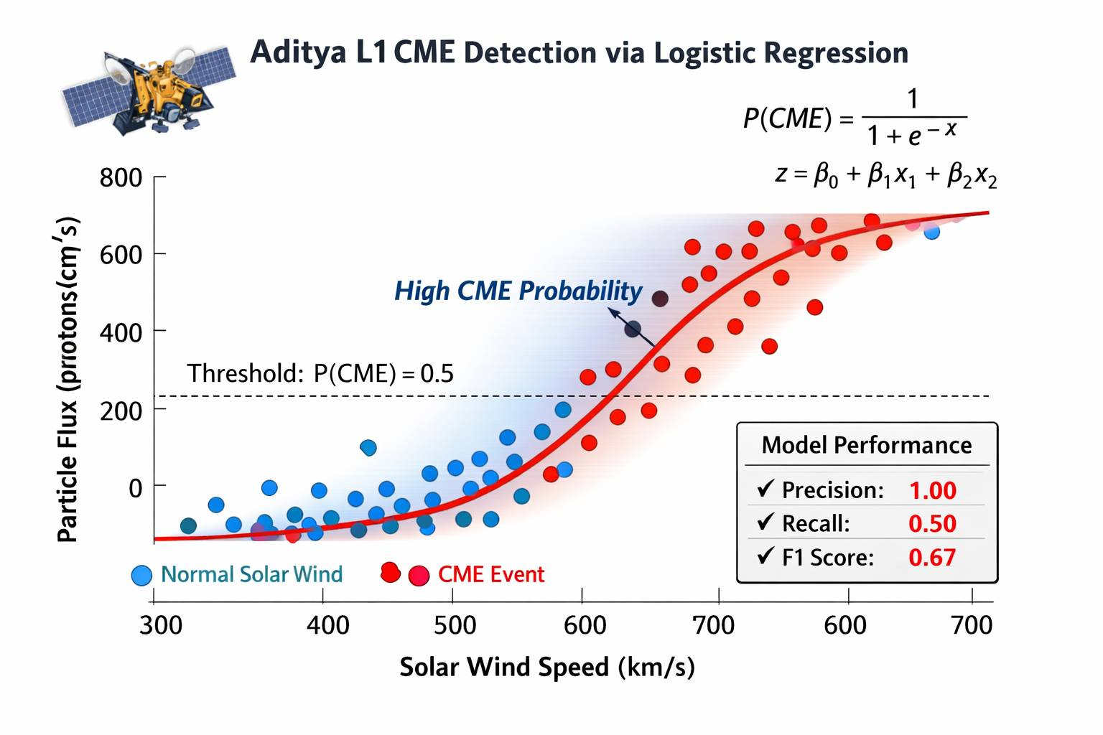
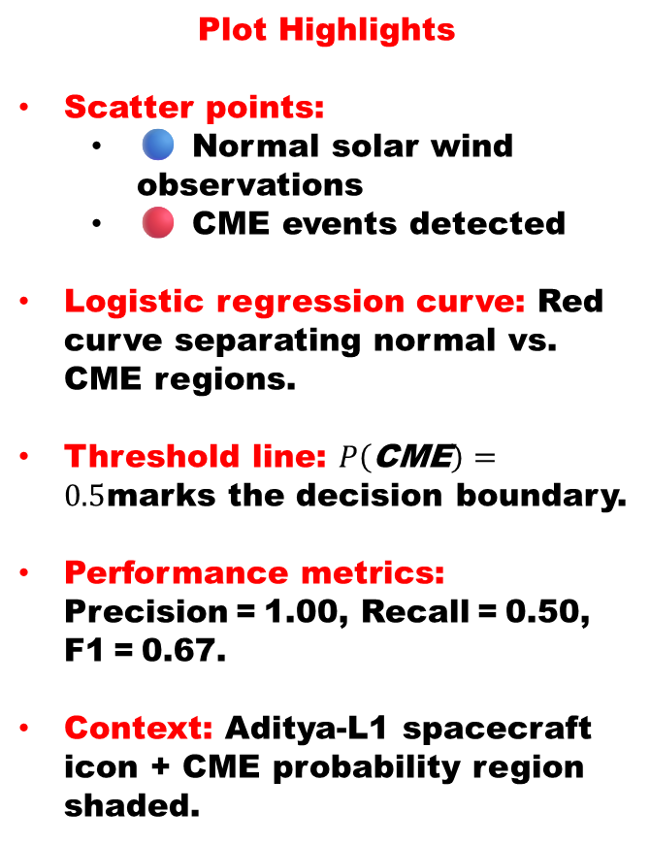
LINEAR REGRESSION
Plot Highlights
Scatter points:
🔵 Normal solar wind observations
🔴 CME events detected
Logistic regression curve: Red curve separating normal vs. CME regions.
Threshold line: $P\left(\text{CME}\right)=0.5$marks the decision boundary.
Performance metrics: Precision = 1.00, Recall = 0.50, F1 = 0.67.
Context: Aditya‑L1 spacecraft icon + CME probability region shaded.

Slide 19
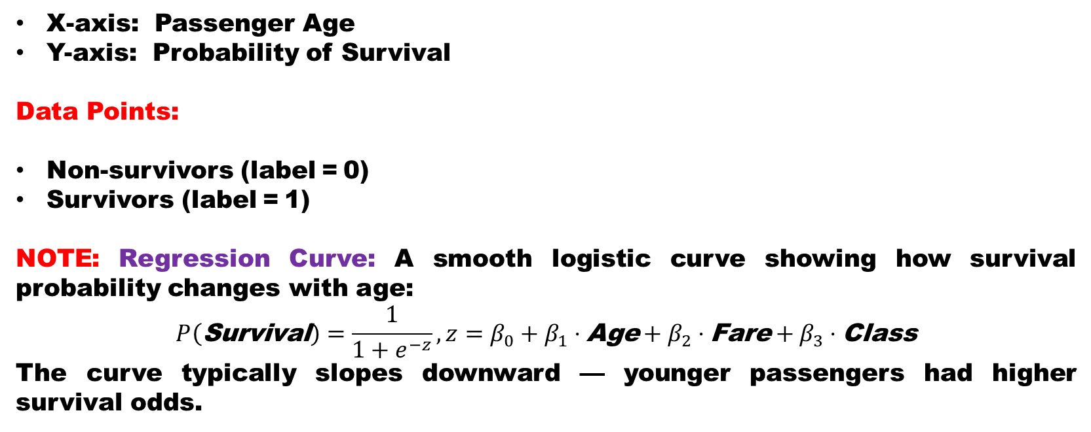
LINEAR REGRESSION
Plot Titanic Survival Prediction via Logistic Regression
X‑axis: Passenger Age
Y‑axis: Probability of Survival
Data Points:
Non‑survivors (label = 0)
Survivors (label = 1)
NOTE: Regression Curve: A smooth logistic curve showing how survival probability changes with age:
$$P\left(\text{Survival}\right)=\frac{1}{1+e^{−z}}, z=β_{0}+β_{1}⋅\text{Age}+β_{2}⋅\text{Fare}+β_{3}⋅\text{Class}$$
The curve typically slopes downward — younger passengers had higher survival odds.

Slide 20
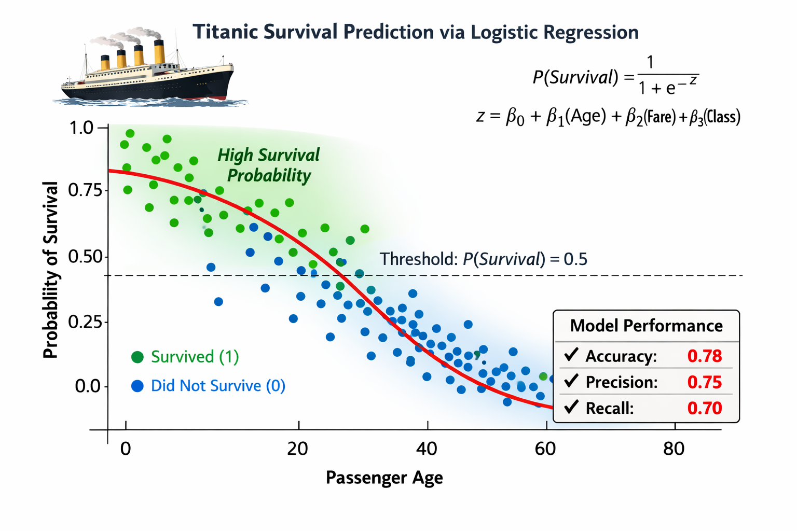
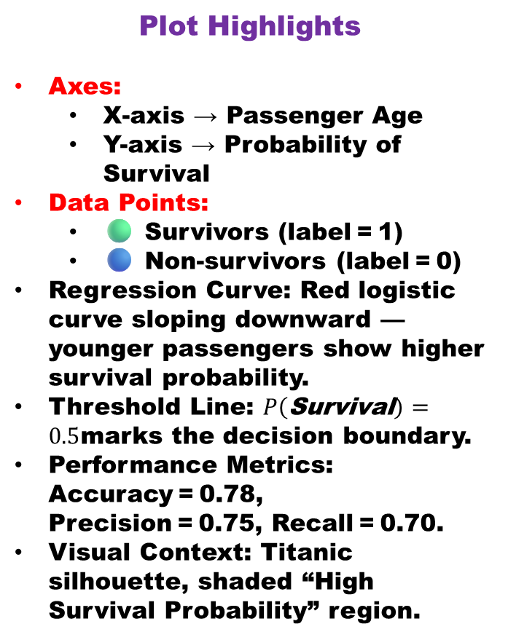
LINEAR REGRESSION
Plot Titanic Survival Prediction via Logistic Regression
Plot Highlights
Axes:
X‑axis → Passenger Age
Y‑axis → Probability of Survival
Data Points:
🟢 Survivors (label = 1)
🔵 Non‑survivors (label = 0)
Regression Curve: Red logistic curve sloping downward — younger passengers show higher survival probability.
Threshold Line: $P\left(\text{Survival}\right)=0.5$marks the decision boundary.
Performance Metrics: Accuracy = 0.78, Precision = 0.75, Recall = 0.70.
Visual Context: Titanic silhouette, shaded “High Survival Probability” region.
NOTE: PLEASE VALIDATE YOUR PLOT WITH MINE SHOWN ABOVE

Slide 21
LINEAR REGRESSION
“Regression analysis is not just a mathematical exercise — it’s a way of seeing the world. It teaches us that every dataset, whether from the depths of the ocean or the vastness of space, carries a hidden pattern waiting to be revealed. Through regression, we learn to connect cause and effect, to predict, and to understand.”
“From Aditya‑L1’s solar data to the Titanic’s survival records, regression reminds us that knowledge is power — the power to foresee, to innovate, and to make decisions grounded in evidence. It’s the bridge between curiosity and clarity, between observation and insight.”

Slide 22
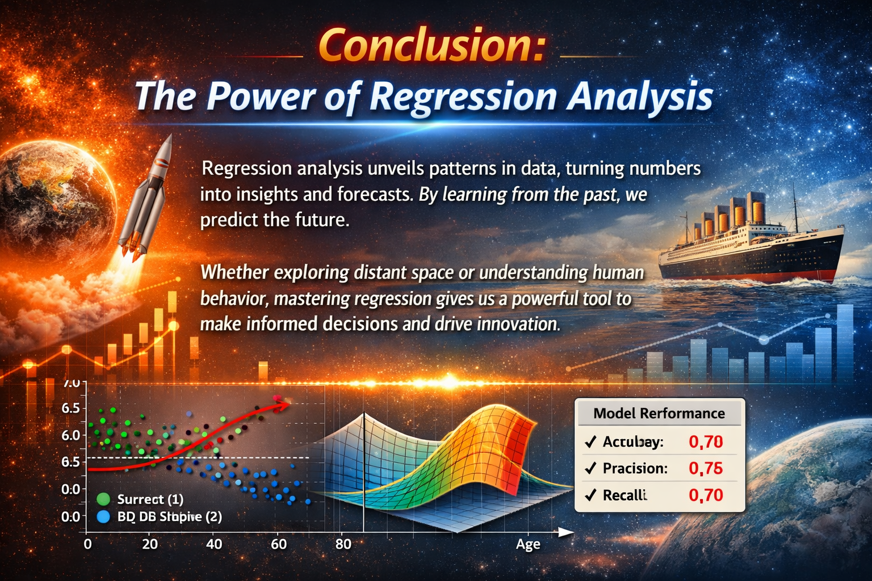
LINEAR REGRESSION
“So as we end today’s session, remember — regression is more than numbers. It’s the language of discovery. And when we master that language, we don’t just analyze data — we illuminate truth.”

Slide 23

LINEAR REGRESSION

